Slide 1
…with LAJEX!!
with LAJEX!!
Notes:
Xochil – sales pitch

Slide 2
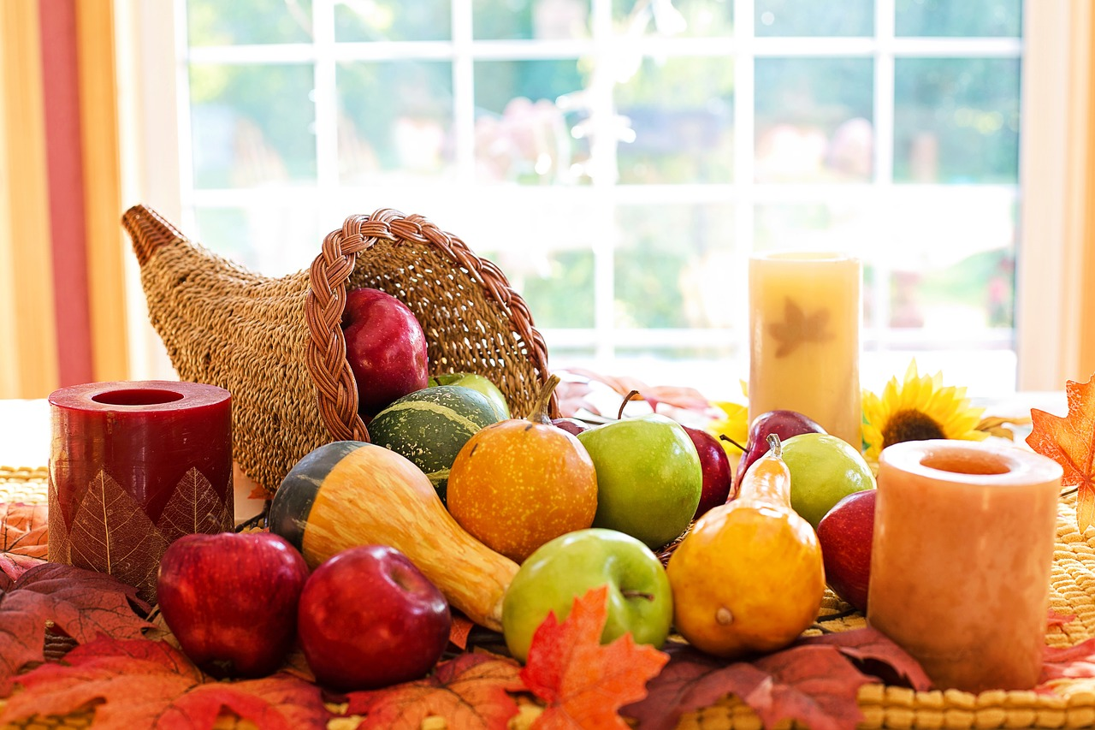
Shopping List Builder
LAJEX Presents…
~Thanksgiving Edition~
CODE 201 – November 3, 2018
Notes:
Lorin

Slide 3



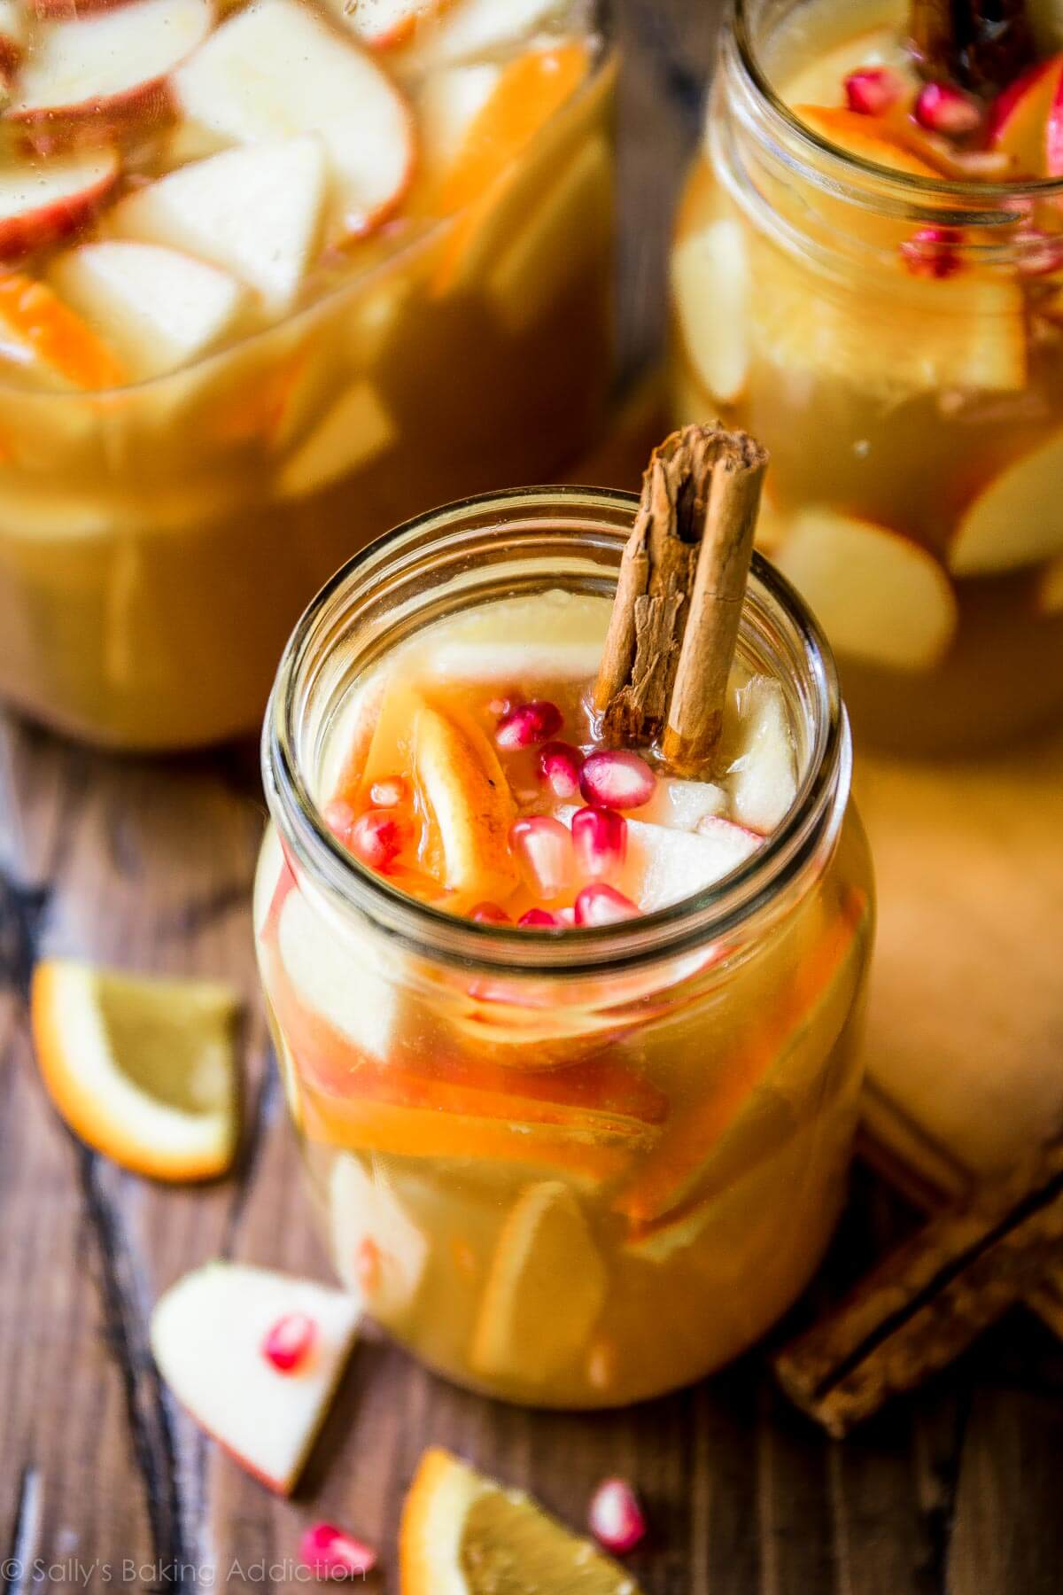


OUR TEAM – SoBasted!
ANTHONY
JULIE
LORIN
ERIN
XOCHIL
Notes:
Each person talks… Lorin … Julie … Anthony … Erin … Xochil

Slide 4
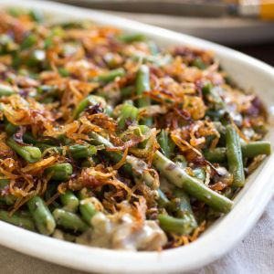
Have you ever…
Notes:
Xochil – sales pitch

Slide 5
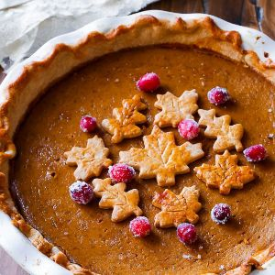
Problem Domain
Create a website that allows the user to choose from group of recipes, build a menu and generate a shopping list of ingredients.
Notes:
Xochil

Slide 6
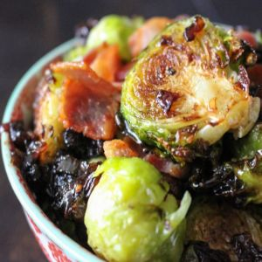
Solution Domain
Click handlers
Added/Removed Recipes from local storage
Used the DOM to change IDS based on user behavior
Math Functions
Reference data from local storage
Loop through all ingredients in the
selected recipe to combine and
manipulate the stored data
Notes:
Xochil

Slide 7
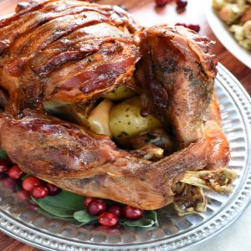
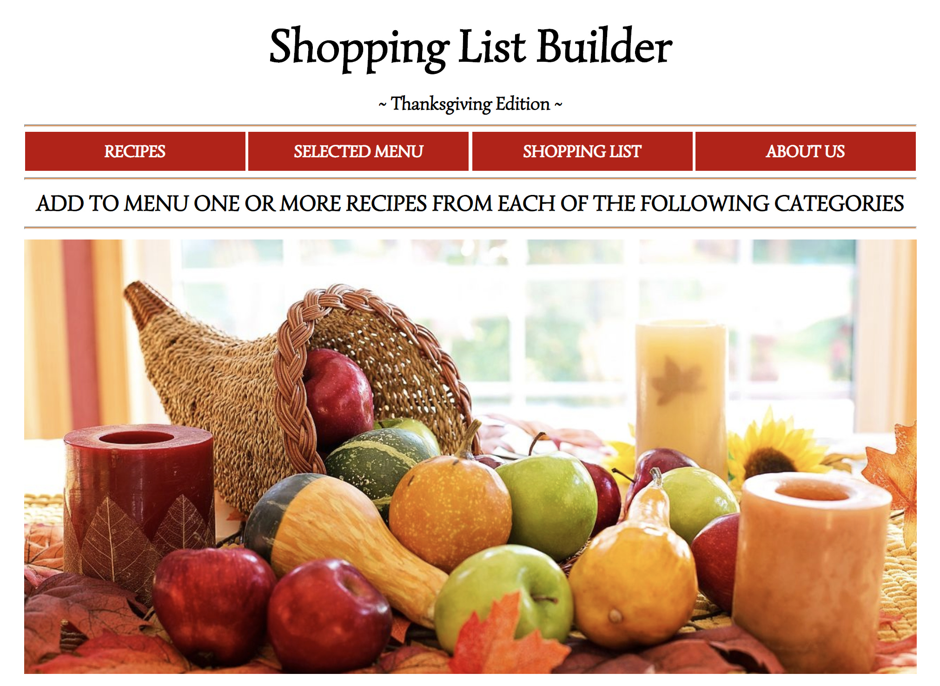
Site Demonstration
Notes:
Erin

Slide 8
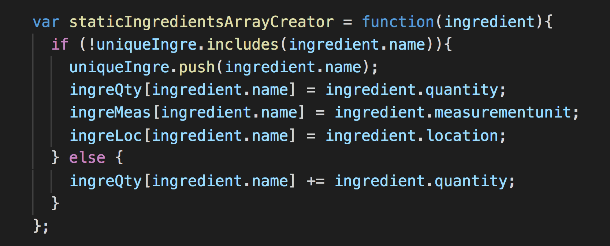
Sum Like Ingredients
Challenge: Combine the quantities and units of ingredients that appear in more than one selected recipe
Example: 2 tablespoons of flour and 1 cup of flour
Notes:
Anthony

Slide 9
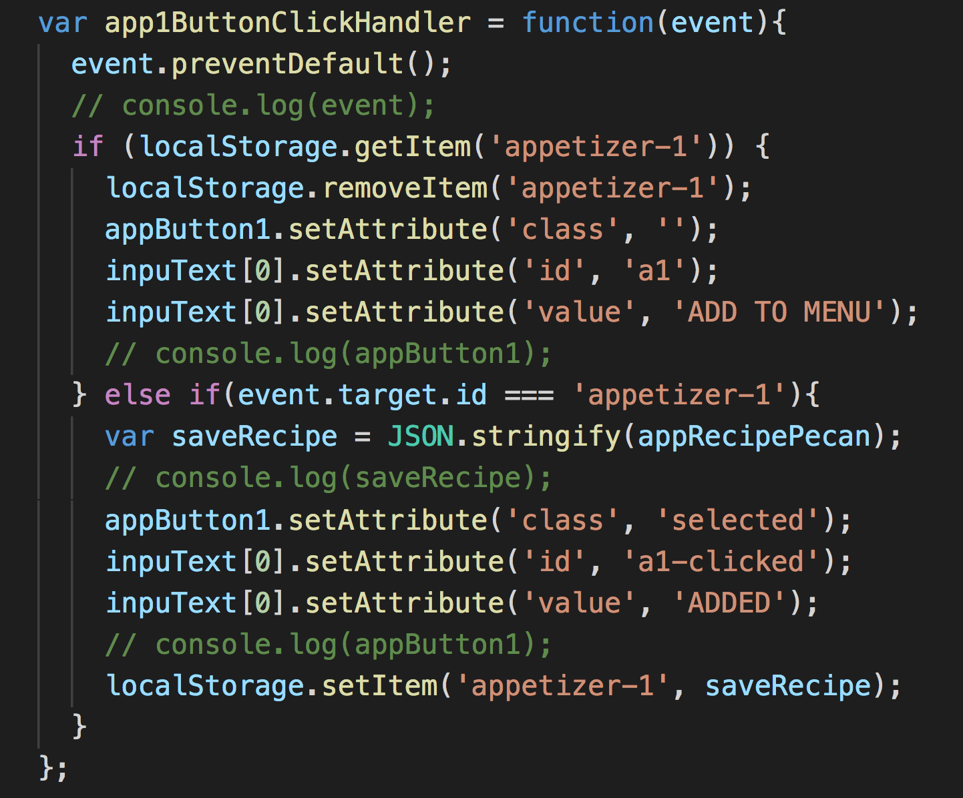
Changing Buttons
Challenge: Create a visual representation of what recipes have been selected by the user that persists on page reload.
Notes:
Lorin

Slide 10
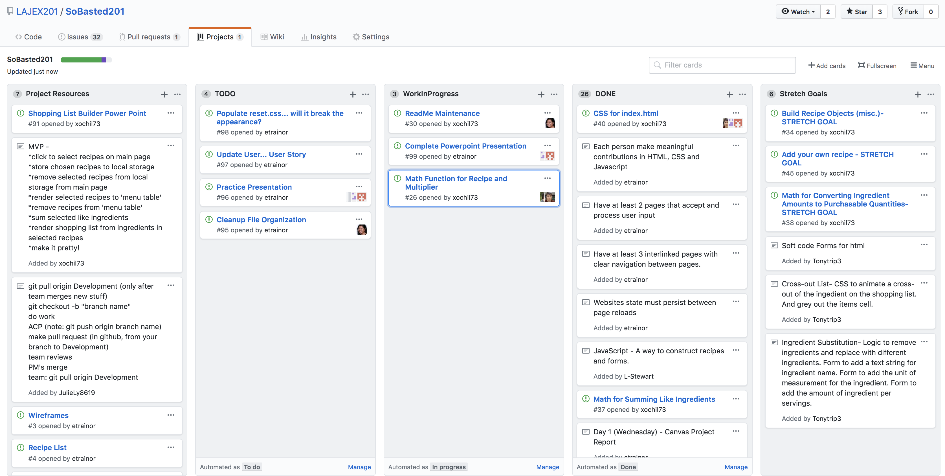
Project Organization – GitHub Projects
Notes:
Julie

Slide 11
Desired Future Functionality
Add your own recipe
Automatically populate recipe data from outside sources using APIs rather than hardcoding each recipe as a separate object
Automatic conversions of different types of units within ingredients
Convert shopping list quantities to purchasable units
Example: Convert cups of flour to pounds of flour
Create a stored recipe database from previous visits to the site
Notes:
Julie

Slide 12
What We Accomplished…
Notes:
Julie

Slide 13
Questions?
CODE 201 – November 3, 2018
Notes:
All

